Slide 1
Non-significance
Brian Caffo, Jeff Leek, Roger Peng
@bcaffo
www.bcaffo.com

Slide 2
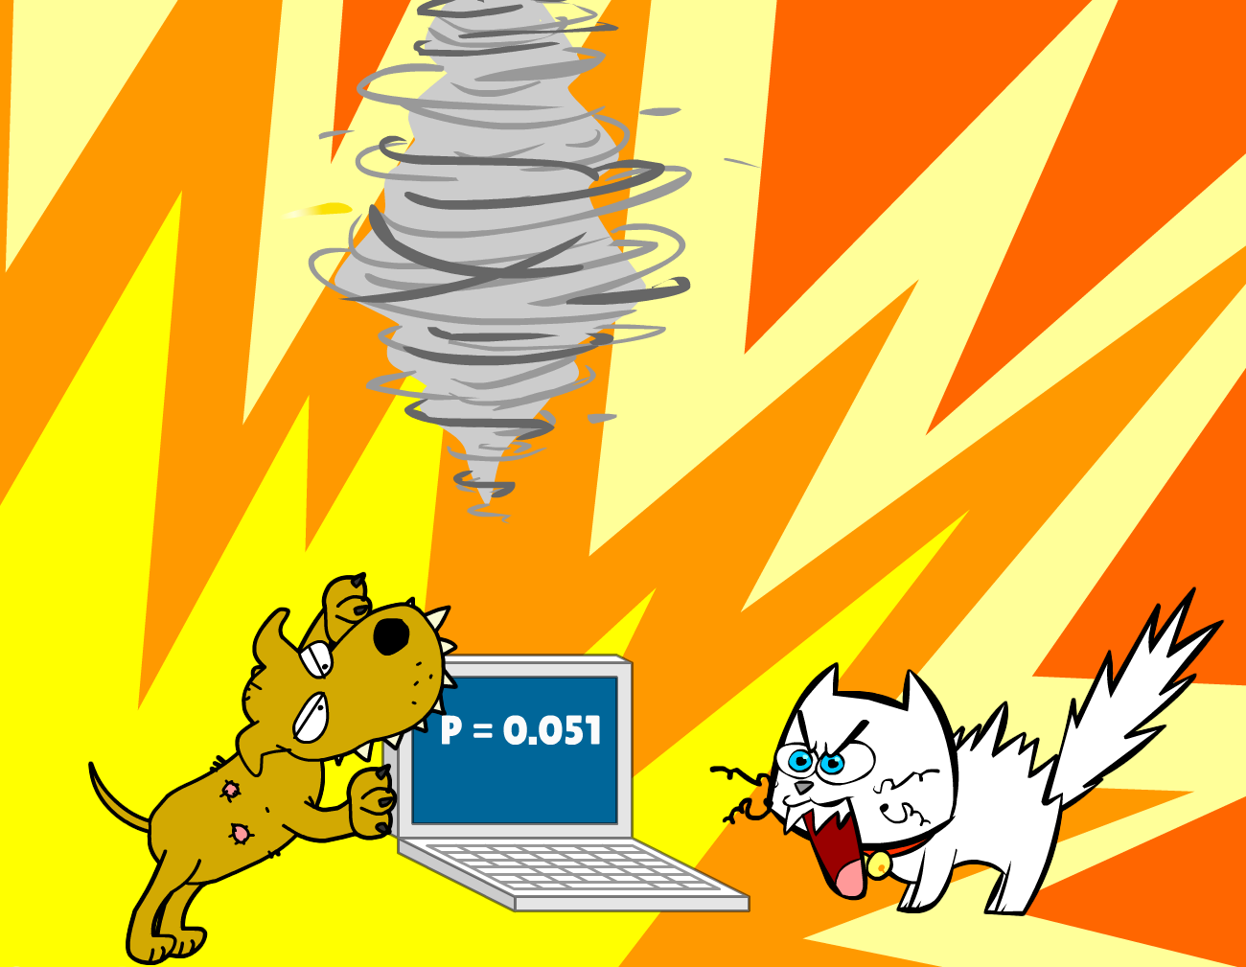

Slide 3
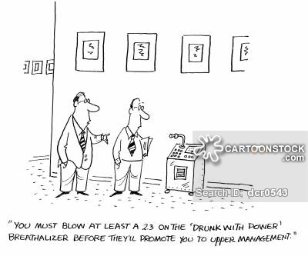
https://www.cartoonstock.com/directory/d/drunk_with_power.asp

Slide 4
Discussion
Most important question in the presence of equivocal results: Was the study set up for failure by not being adequately powered
Power = the probability of detecting an effect that is truly there
sample size increases power
size of the true effect increases power
lower variance increases power
often power / sample size calculations are done prior to conducting a study to set it up for success

Slide 5
Post hoc there’s little that can be done about power, other than adding to the study or starting a new one
Post hoc power calculations are known to have serious issues
Critical discussion of the strength of the study is main recourse.

